Slide 1
RECOGNIZING EMOTIONAL STATES WITH WEARABLES WHILE PLAYING A SERIOUS GAME
Guided by,
V. VASANTHI M.C.A., M.Phil., PhD.,
Associate Professor
Department of Computer Science
Presented By,
B. BHAVYADHARSHINI

Slide 2
CONTENTS
Abstract
Introduction
Literature Survey
Existing system
Proposed system
Software Requirements
Hardware Requirements

Slide 3
ABSTRACT
Facial emotion recognition is a critical task in computer vision with numerous applications ranging from human-computer interaction to mental health monitoring. This system presents a real- time facial emotion recognition system utilizing a convolutional neural network (CNN) trained on the FER-2013 dataset. The system captures video frames from a webcam feed, detects faces using Haar cascade classifier, and extracts facial regions. These regions are preprocessed and fed into the pre-trained CNN model, which predicts the emotion expressed in the face. The model recognizes seven basic emotions: neutral, happiness, surprise, sadness, anger, disgust, and fear. Detected emotions are overlayed on the video feed in real-time. This implementation provides a simple yet effective approach for real-time facial emotion recognition, demonstrating the potential of deep learning in understanding human expressions.

Slide 4
INTRODUCTION
The problem addressed by the system is real-time facial emotion recognition using computer vision and deep learning techniques. Facial emotion recognition involves the identification and analysis of facial expressions to infer the underlying emotional states of individuals. This problem is crucial in various domains, including human-computer interaction, mental health monitoring, market research, and security surveillance.
Real-time Processing
Face Detection
Facial Region Extraction
Preprocessing
Emotion Recognition

Slide 5
EXISTING SYSTEM
Face detection is commonly performed using methods like Haar cascade classifiers. However, these traditional approaches may struggle to accurately capture subtle facial expressions and might require significant domain knowledge for feature engineering.
Advantages:
Proven Technology
Real-time Performance
Accessibility
Disadvantages:
Limited Emotion Recognition
Dependency on Lighting and Pose

Slide 6
PROPOSED SYSTEM
Proposed system:
The proposed system leverages deep learning techniques, particularly convolutional neural networks (CNNs), to address the limitations of traditional methods. CNNs can automatically learn hierarchical features directly from raw pixel data, enabling them to capture complex patterns and nuances in facial expressions more effectively. In the proposed system, video frames are captured from a webcam feed, and faces are detected using a Haar cascade classifier.
Advantages:
Improved Emotion Recognition
Enhanced User Experience

Slide 7
MODULES
1.Load Dataset:
Load data set using pandas read_csv() method.
2.Split Data Set:
Split the data set to two types. One is train data test and another one is test data set.
3.Train data set:
Train data set will train our data set using fit method.
4.Test data set:
Test data set will test the data set using algorithm.
5.Predict data set:
Predict() method will predict the results.

Slide 8
SOFTWARE REQUIREMENTS SPECIFICATIONS
Hardware requirement
Memory - 8GB RAM
Intel I5 Core Processor
Hard Disk : 250 Gb
Software requirement
Operating System: windows, linux
Python i3.7

Slide 9
PROPOSED MODEL DIAGRAM
Import trained Model
Preprocess that Model
Emotion Detection
Open the Live Cam
Detect the face

Slide 10

OUTPUT SCREENS

Slide 11
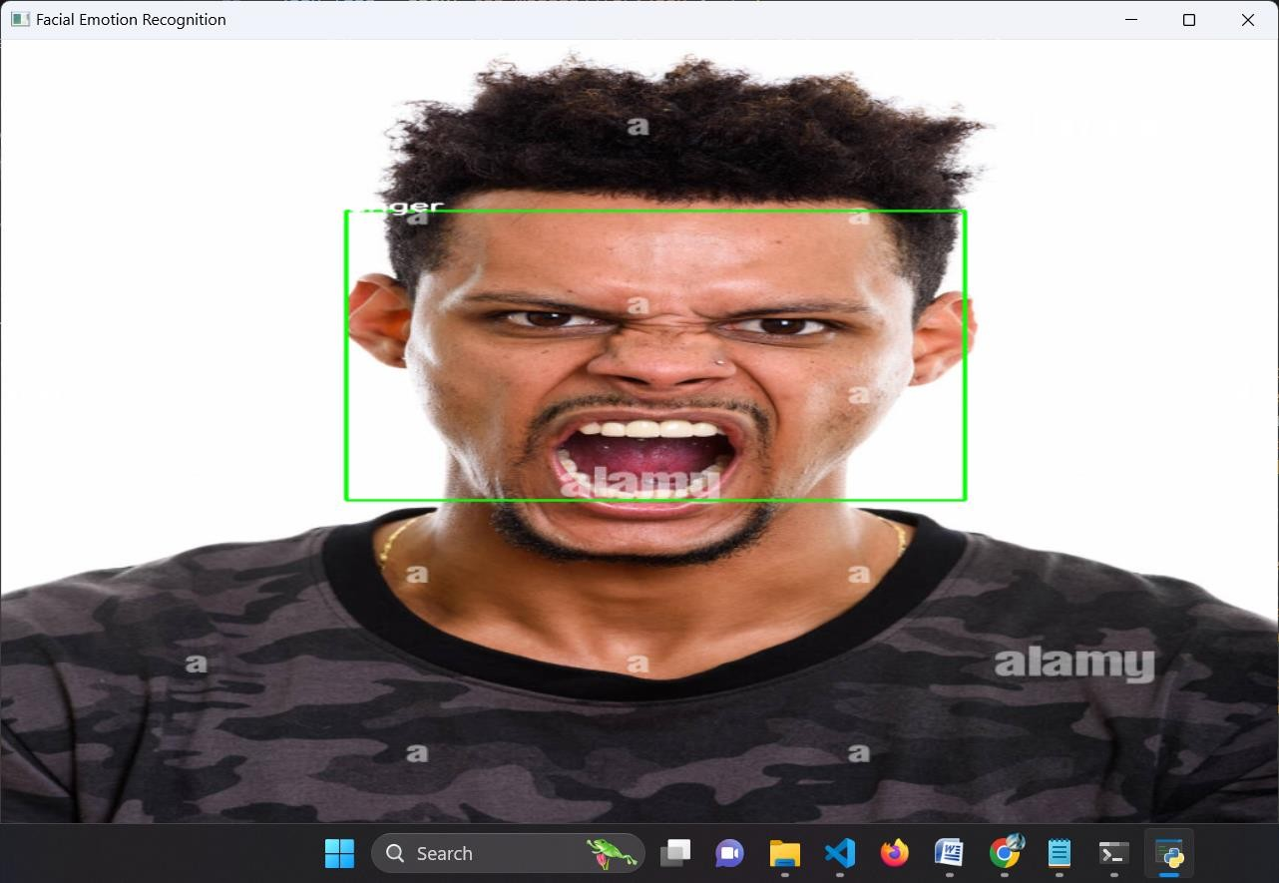
OUTPUT SCREENS

Slide 12
CONCLUSION
In conclusion, the implemented system showcases the integration of computer vision and deep learning techniques for real-time facial emotion recognition. By leveraging pre-trained convolutional neural network (CNN) models and Haar cascade classifiers, the system can accurately detect faces in live webcam video feeds and predict the corresponding emotions expressed by individuals.

Slide 13
REFERENCES
1. Wesley J. Chun, “Core Python Programming”, Second Edition, Prentice Hall Publication, 2006.
2. Timothy A Budd, “Exploring Python”, Tata McGraw Hill, New Delhi, ISBN:780071321228
3. “Digital Image Processing”, S. Sridhar, Oxford University Press; Second edition, 2016.

Slide 14
THANK YOU!!

